Slide 1













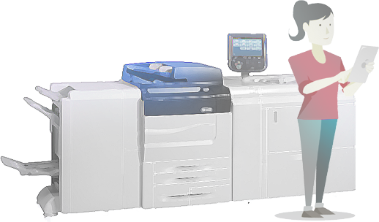
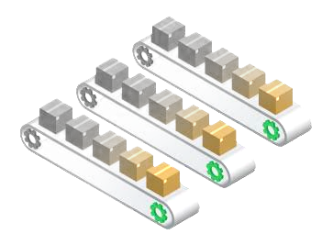
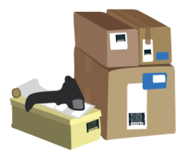







version 1.6
DoReMi Online Order Management System
Music Book and Scores Publishers
DoReMi Order Management System re-order products from publishers and provides a way for DoReMi to manage invoices from publishers.
Sales Team access DoReMi's Order Management System to set global discounts for festive seasons. DoReMi's Business Intelligence Rules module automatically adjust all sales orders discount accordingly.
DoReMi Business Intelligence System executes and manages process workflows with rules setup in a custom Rules Engine.
Customers
Music School A
Music School A
4
7
Status: Closed
Music School B
Music School B
Products are received by DoReMi's customers. Sales order status is updated to DoReMi's Order Managemnt System via Web API .
Music School C
Music School C
DoReMi
Orders Books or musical scores with Customer Service / Sales
DoReMi Online Order Management System
1
Status: Draft
4
Music schools place orders with DoReMi Customer Service / Sales. Customer Service enters orders into DoReMi's Order Management System using a modern web interface.
Accounts notify Customer Service of cancelled sales orders
5
Status: Packing
3b
Status: Printing
Warehouse packaging team receives notification to pack products. They verify orders are approved, complete packing of products, updates order's status to “Packing”, and finally, they arrange delivery of products to customers.
In-House Printering operations
Print-On-Demand
Prints bulk orders of musical scores
DoReMi
Sales / Customer Service
2
Status: Confirmed
4
Status: Cancelled
3
Status: Approved
Customer Service confirms orders with schools and update the sales orders recorded in DoReMi's Order Management System.
DoReMi Business Intelligence Rules module automatically sends notifcations to Accounts Team on any confirmed sales orders that are above auto-approval limits. Accounts reviews and updates DoReMi's Order Management System. Accounts team cancels the sales orders if their credit risk are high.
DoReMe's Business Intelligent Process Rules automatically approves orders and notify warehouse packaging team to prepare packing of products for delivery. The inventory control is activated by the Order Management System and products stock balance are updated. Stock re-order may be started depanding on the automation setup. (A PO is raised for stock re-order)
6
Status: Shipping
Whenever packed products are ready to be shipped, DoReMi's packaging team updates the sales orders and set them to the status “Shipping”. At the same time, DoreMi's Order Management System automatically notify customer service of the shipment.

